Slide 1
LANE DETECTION FOR AUTONOMOUS VEHICLES USING OPENCV
Under Guidance of
Mrs. M. JYOTHIRANI
Submitted by,
CH.VAMSHI(4511-18-733-017) K.SHIVAPRASAD(4511-18-733-016) P.SHRAVYA(4511-18-733-034)

Slide 2
CONTENTS
▶ 1. ABSTRACT
▶ 2. INTRODUCTION
▶ 3. EXISTING SYSTEM & DISADVANATGES
▶ 4. PROPOSED SYSTEM & ADVANTAGES
▶ 5. ARCHITECTURE / BLOCK DIAGRAM
▶ 6. SYSTEM REQUIREMENT SPECIFICATION
▶ 7.MODULES & THEIR DISCRIPTION
▶ 8.UML DIAGRAMS
▶ 9. OUTPUT SCREENS
▶ 10. CONCLUSION
▶ 11. FUTURE ENHANCEMENT
▶ 12. REFERENCES & BIBLOGRAPHY

Slide 3
ABSTRACT
Autonomous driving car is one of the most disruptive innovations in AI.
The main objective is to vehicle can able to drive by themselves , without any human
interaction.
One of the many steps involved during the training of an autonomous driving car is lane detection, which is the preliminary step. Today, we are going to learn how to perform lane detection using videos.
Based on the problems encountered in detecting objects by autonomous vehicles an effort has been made to demonstrate lane detection using OpenCV library
It carries out Grayscale instead of color , Gaussian smoothing , Canny edge detection, selecting region of interest , Hough transformation for line detection.

Slide 4
INTRODUCTION
An autonomous car can go anywhere a traditional car can go and does everything that an experienced human driver does.
But it’s very essential to train it properly.
One of the many steps involved during the training of an autonomous driving car is lane detection, which is the preliminary step.
Today, we are going to learn how to perform lane detection using videos.
Driver Assistant System is designed to assist drivers in the perception of any dangerous situations before, to avoid accidents after sensing and understanding the environment around itself
More and more accidents can be avoided if such dangerous driving condition is detected early and warned to other drivers. Most of the roads, cameras and speed sensors are used for monitoring and identifying drivers who exceed the permissible speed limit on roads and motorways. This simplistic approach, and there are no restrictions.

Slide 5
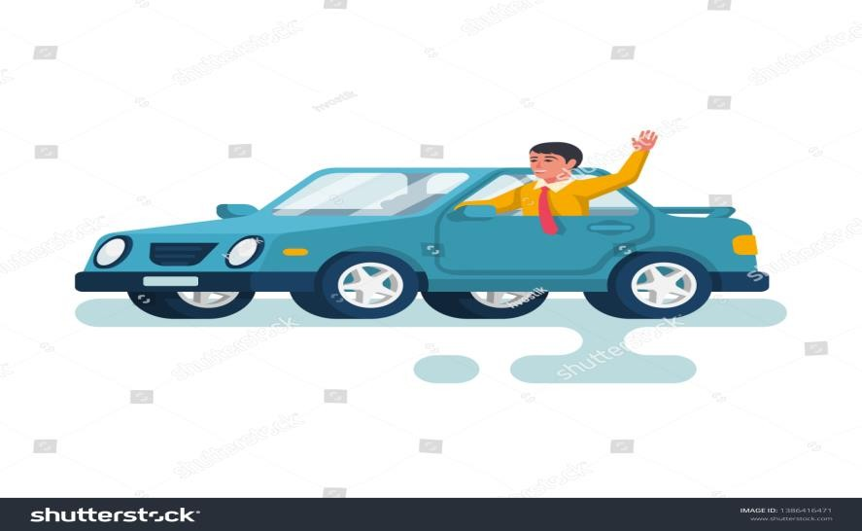
EXISTING SYSTEM
In this World Human driving is a like Habit to everyone like driving car , bike…etc.
Mainly in Human Diving helps lot of people to creating the job opportunities .
How Human can Master on the Driving ?.It is practice to learn and train in different driving
centres with follow road rules.
Human Driving is not Good at Every time because it depends on person it behaviour in the process of diving.
Because Humans are filled by Emotions, they cannot restrict under traffic rules and
safety driving rules.

Slide 6
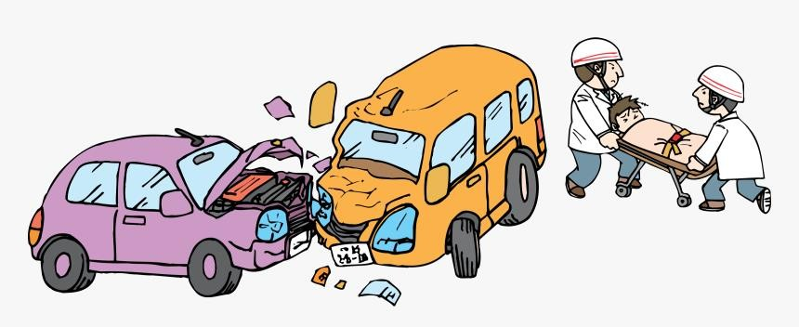
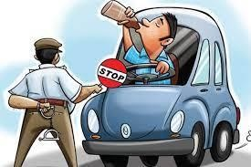
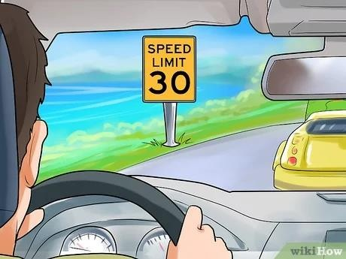
DISSADVANTAGES
Human drivers often bend traffic rules and take risks, even breaking laws and rules and
posted speed limit, making the roads not safety to Everyone.
The average annual road accidents death crashes stand at 1.3 lakh per year in India.
Drunk driving is a serious problem that continues to take thousands of deaths each year. Too many innocent lives been lost to drunk driving.
Human can go to long distances travelling, it takes more human effort. It causes different Health issues like backpain ..etc.

Slide 7
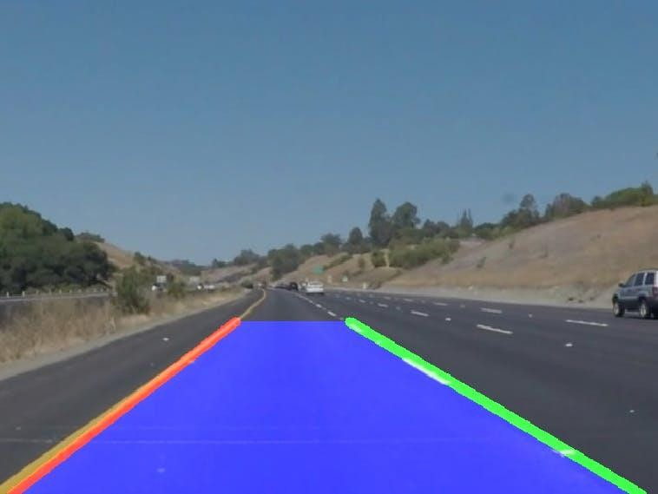
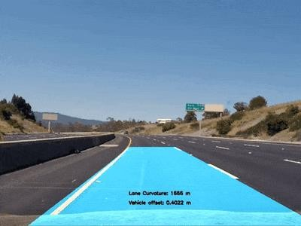
PROPOSED SYSTEM
Self driving is the most trending technology Now days. It mainly depends on object detection and lane detection.
Lane Detection is Nothing But detecting the lanes on the road.
detecting lanes using Python and OpenCV. In real time vehicular movements will be captured using a camera and the same will be processed to achieve the goal. The Hough Transform is used to detect lanes in an image or video.

Slide 8
ADVANTAGES
The autonomous vehicle can move successfully without a driver help. They can go from the initial point to the specified target by applying pre-defined rules. Hence it is reduces human effort for mainly in long distances.
To control accidents are caused due to insufficient follow-up of the lanes and non-compliance with these rules and drunk-drive. The majority of these accidents also result in injury and death.
Efficient travel means fuel savings for travelers.
Greater efficiency would mean fewer emissions and less pollution from cars, meaning a lower
negative environmental impact.
Autonomous Vehicles follow traffic rules.
No risk of drunk and drive.
Increase efficiency of time in travelling and fuel .

Slide 9
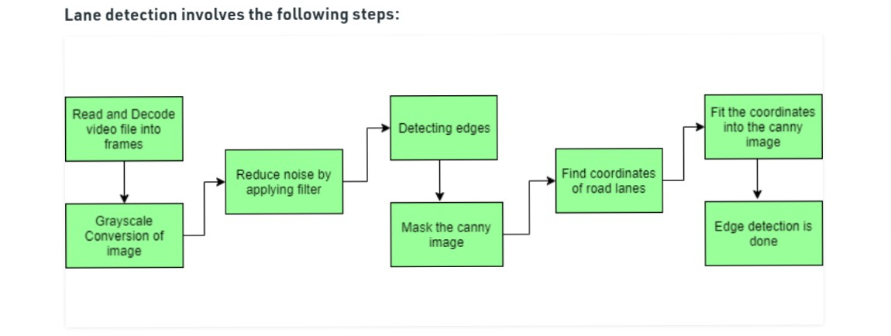
BLOCK DIAGRAM

Slide 10
SYSTEM REQUIREMENTS
Operating system:windows10 pro
Coding language: Python(3.0)
Domain: Machine learning
HARDWARE REQUIREMENTS
PROCESSOR:2.70GHz
RAM :4 GB
HARD DISK:320 GB

Slide 11
MODULES & DESCRIPTION
Capturing and decoding video file
Grayscale conversion of image
Reduce noise
Canny Edge Detector
Region of Interest
Hough Line Transform

Slide 12
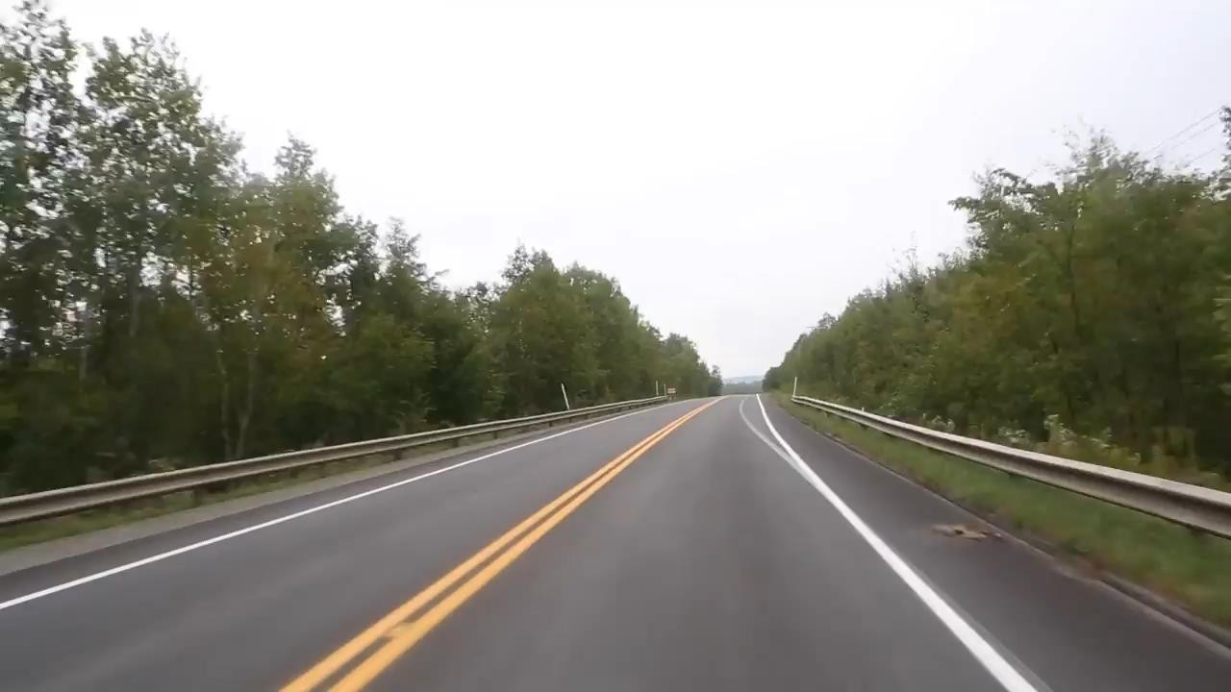
Capturing and decoding video file: We will capture the video using Video Capture object and after the capturing has been initialized every video frame is decoded (i.e. converting into a sequence of images).

Slide 13
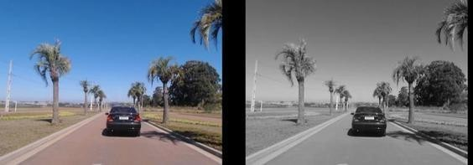
Grayscale conversion of image: The video frames are in RGB format, RGB is converted to grayscale because processing a single channel image is faster than processing a three- channel colored image.
Before and after gray scale image of road

Slide 14
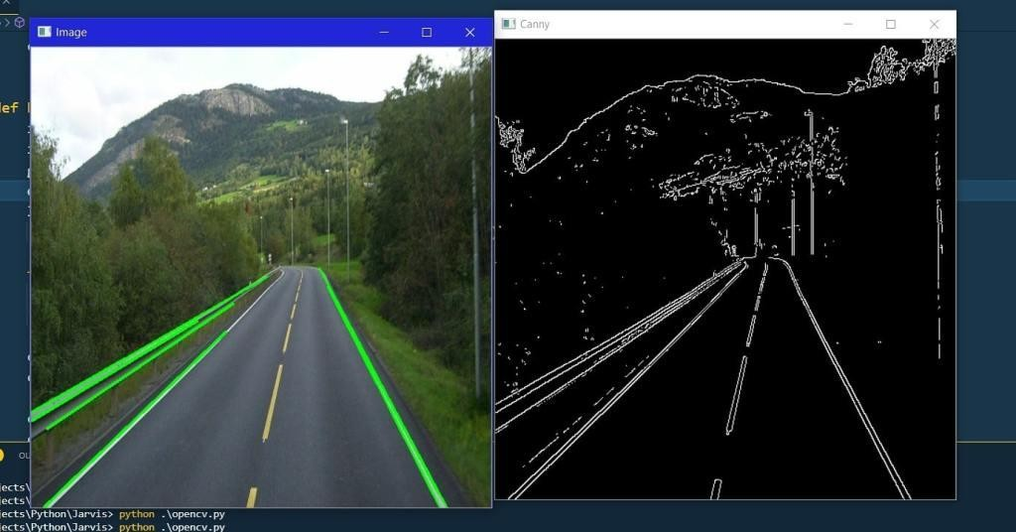
Reduce noise: Noise can create false edges, therefore before going further, it’s imperative
to perform image smoothening. Gaussian filter is used to perform this process
Canny Edge Detector: It computes gradient in all directions of our blurred image and traces the edges with large changes in intensity . For more explanation please go through this article

Slide 15

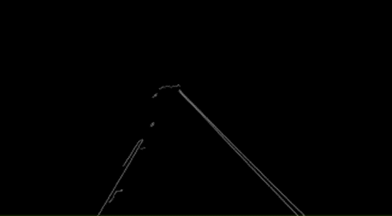
Region of Interest: his step is to take into account only the region covered by the road lane. A mask is created here, which is of the same dimension as our road image. Furthermore, bitwise AND operation is performed between each pixel of our canny image and this mask. It ultimately masks the canny image and shows the region of interest traced by the polygonal contour of the mask.
Region of interest of road
Canny edges of road

Slide 16
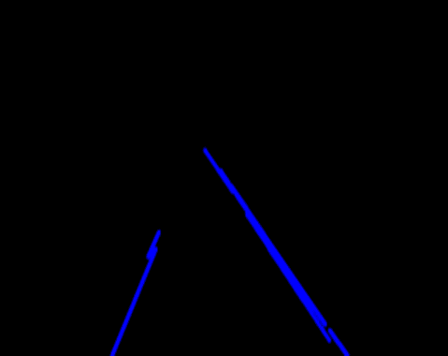
▶ Hough Line Transform: The Hough Line Transform is a transform used to detect straight lines. The Probabilistic Hough Line Transform is used here, which gives output as the extremes of the detected lines.
Hough transformation of road

Slide 17
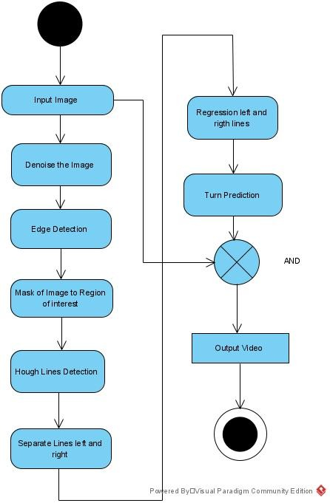
UML DIAGRAMS
Activity Diagram

Slide 18
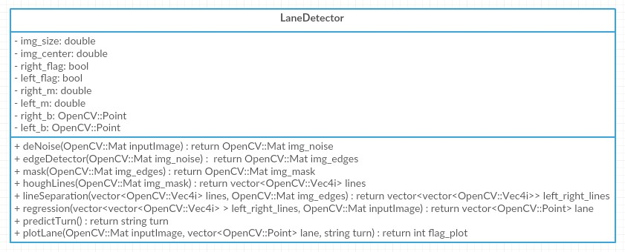
CLASS DIAGRAM

Slide 19
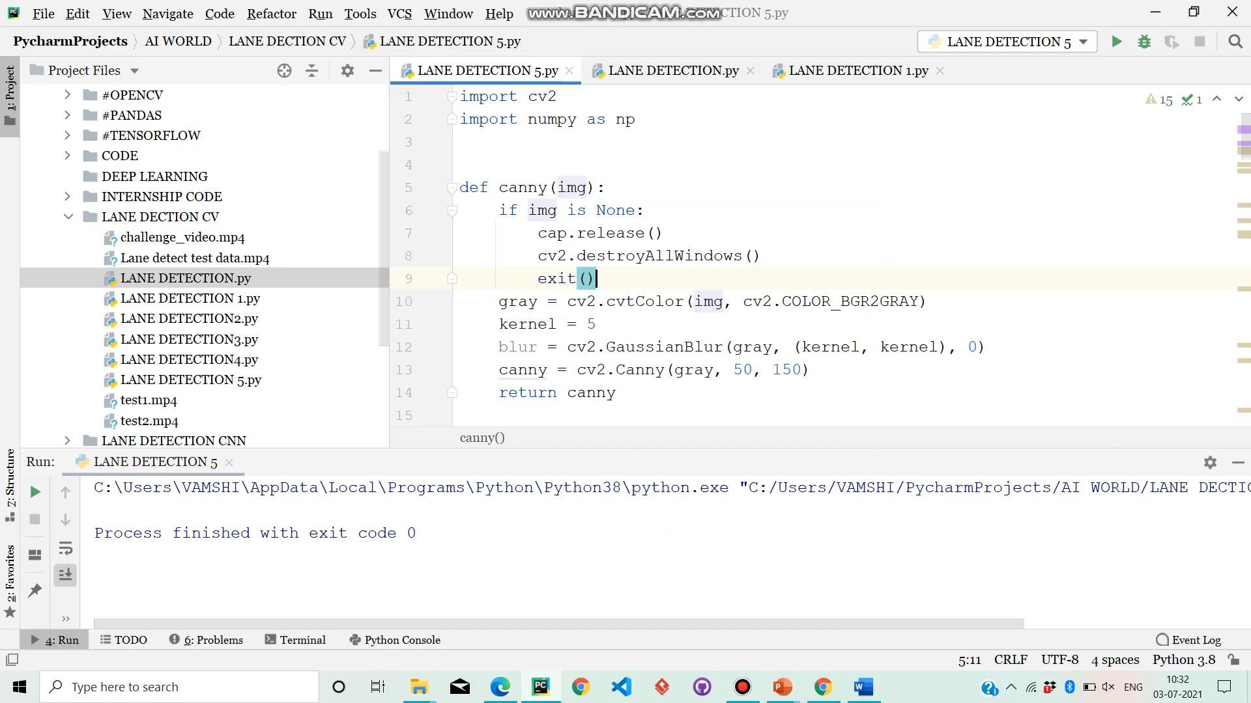
OUTPUT SCREEN

Slide 20
CONCLUSION
In the methodology, we made use of the OpenCV library and its functions such as the Canny
Function through which we achieved edge detection.
Then we prepared a mask of zero intensity and mapped our region of interest by performing the bitwise operation. Then we used the Hough Transform technique that detected the straight lines in the image and identified the lane lines.
We made use of the polar coordinates since the Cartesian coordinates don’t give us an appropriate slope of vertical and horizontal lines. Finally, we combined the lane image with our zero-intensity image to show lane lines

Slide 21
FUTURE ENHANCEMENT
This model can be updated and tuned with more efficient mathematical modelling, whereas the classical OpenCV approach is limited .
and no upgrade is possible as the approach is not efficient It is unable to give accurate results on
the roads which do not have clear markings present on the roads.
Also it cannot work for all climatic conditions This technology is increasing the number of applications such as traffic control, traffic monitoring, traffic flow, security etc.
The importance of perception sensors, algorithms and their integration to achieve the optimized results for a lane detection.
Advance study on efficient integration of sensors to minimize computation time, cost and increase effective perception is required.

Slide 22
REFERENCES
htttp://www.kaggle.com/c/walmart-recruiting-stores-sales-forecasting
https://towardsdatascience.com/introduction-to-machine-learningalgorithms-linear - regression
www.kdnuggets.com

Slide 23
THANK YOU

